Slide 1
Chapter 4: Threads
Overview
Multithreading Models
Thread Libraries
Threading Issues
Operating System Examples
Windows XP Threads
Linux Threads

Slide 2
Motivation
Threads run within application
Multiple tasks with the application can be implemented by separate threads
Update display
Fetch data
Spell checking
Answer a network request
Process creation is heavy-weight while thread creation is light-weight
Can simplify code, increase efficiency
Kernels are generally multithreaded

Slide 3
Thread Concept
A thread is a “lightweight” process which executes within the address space of a process.
A thread can be scheduled to run on a CPU as an independent unit and terminate.
Multiple threads can run simultaneously.

Slide 4
Thread Concept
Threads have their own
Thread ID (just like process id)
CPU context (PC, SP, register set, etc.)
Stack
Priority
Errno (if any error fails then error reason will be in Errno)

Slide 5
?
Threads share
Code and data
Open files (through the PPFDT)
Current working directory
User and group IDs
Signal setups and handlers
PCB

Slide 6
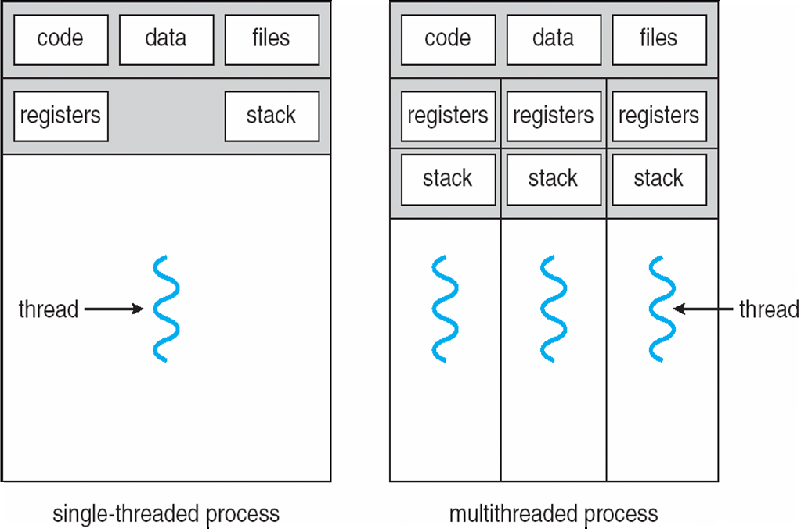
Single and Multithreaded Processes
you need to Create CPU context
and stack.

Slide 7
Threads are Similar to Processes
A thread can be in states similar to a process (new, ready, running, blocked, terminated)
A thread can create another thread

Slide 8
Threads are Different from Processes
Multiple threads can operate within the same address space.
No “automatic” protection mechanism is in place for threads—they are meant to help each other

Slide 9
Advantages of Threads
Responsiveness
Multi-threaded servers (e.g., browsers) can allow interaction with user while a thread is formulating response to a previous user query (e.g., rendering a web page)

Slide 10
Benefits
Responsiveness
Resource Sharing
Economy
Scalability

Slide 11
Multicore Programming
Multicore systems putting pressure on programmers, challenges include:
Dividing activities
Balance
Data splitting
Data dependency
Testing and debugging

Slide 12
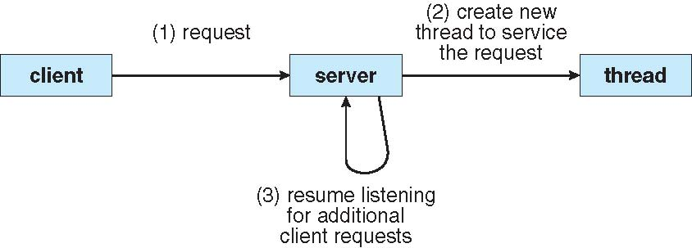
Multithreaded Server Architecture

Slide 13
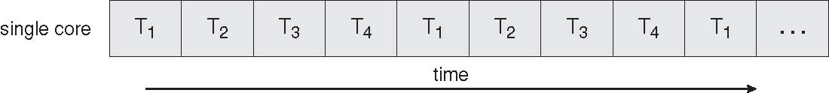
Concurrent Execution on a Single-core System

Slide 14
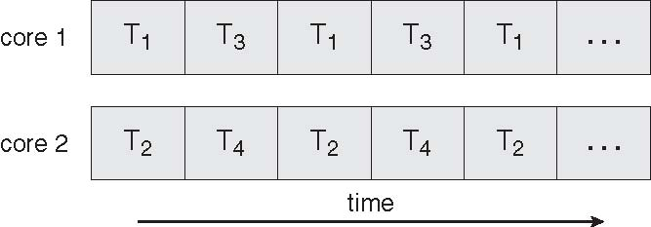
Parallel Execution on a Multicore System

Slide 15
User Threads
Thread management done by user-level threads library
Three primary thread libraries:
POSIX Pthreads
Win32 threads
Java threads

Slide 16
Kernel Threads
Supported by the Kernel
Examples
Windows XP/2000
Solaris
Linux
Tru64 UNIX
Mac OS X

Slide 17
Multithreading Models
Many-to-One
One-to-One
Many-to-Many

Slide 18
Many-to-One
Many user-level threads mapped to single kernel thread
Examples:
Solaris Green Threads
GNU Portable Threads

Slide 19
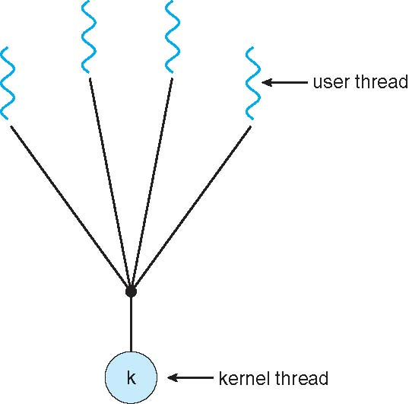
Many-to-One Model

Slide 20
One-to-One
Each user-level thread maps to kernel thread
Examples
Windows NT/XP/2000
Linux
Solaris 9 and later

Slide 21
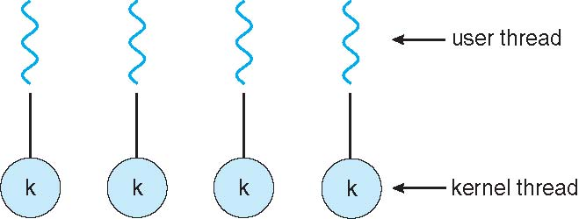
One-to-one Model

Slide 22
Many-to-Many Model
Allows many user level threads to be mapped to many kernel threads
Allows the operating system to create a sufficient number of kernel threads
Solaris prior to version 9
Windows NT/2000 with the ThreadFiber package

Slide 23
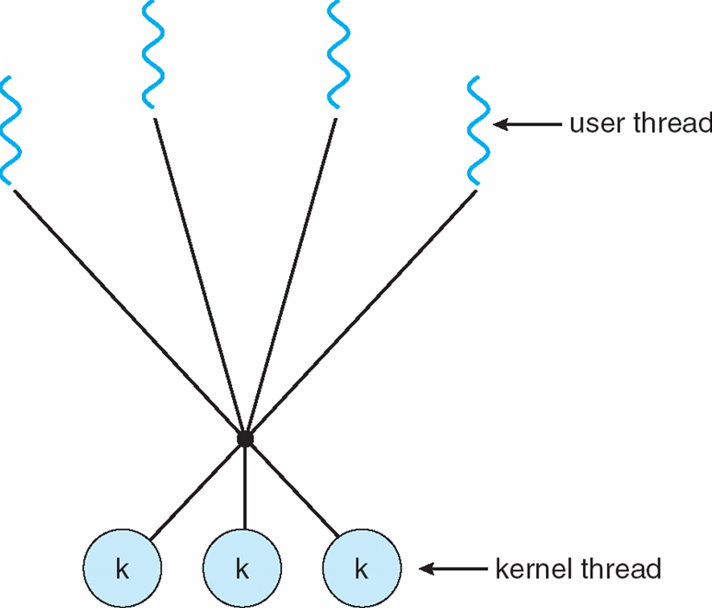
Many-to-Many Model

Slide 24
Two-level Model
Similar to M:M, except that it allows a user thread to be bound to kernel thread
Examples
IRIX
HP-UX
Tru64 UNIX
Solaris 8 and earlier

Slide 25
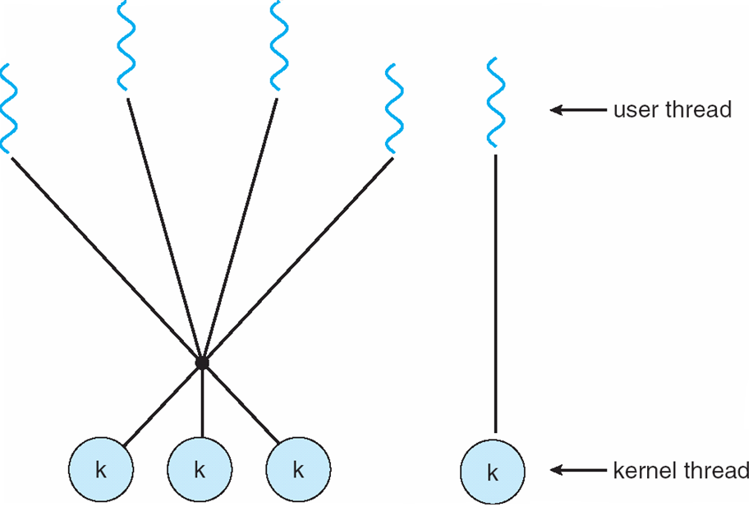
Two-level Model

Slide 26
Thread Libraries
Thread library provides programmer with API for creating and managing threads
Two primary ways of implementing
Library entirely in user space
Kernel-level library supported by the OS

Slide 27
Solaris 2 Threads Model
▪ Solaris 2: threads, light-weight processes (LWPs), and processes
▪ At least one LWP per process to allow a user thread to talk to a
kernel thread
▪User level threads switched and scheduled among LWPs without
kernel’s knowledge
▪ One kernel thread per LWP; some kernel threads have no LWP (e.g., threads for clock interrupt handler and scheduling)

Slide 28
Solaris 2 Threads Model

Slide 29
Pthreads
A POSIX standard (IEEE 1003.1c) API for thread creation, termination, and synchronization.
API specifies the behavior of the thread library, implementation is up to developers of the library.
Common in UNIX operating systems.
Detail in Ch#7

Slide 30
Creating a Thread
Thread id
int pthread_create (pthread_t *threadp,
const pthread_attr_t *attr,
void* (*routine)(void *),
arg *arg
);
Specific Attributes
The name of function
Which we make thread

Slide 31
Creating a Thread
Where:
Threadp: The thread we are trying to create—thread ID (TID)
Attr: Used to modify the thread attributes (stack size,stack address, joinable,detached,priority, etc.)
Routine: The thread function
Arg: Any argument we want to pass to the thread function. This does not have to be a simple native type, it can be a ‘struct’ of whatever we want to pass in.

Slide 32
Error Handling
pthread_create() fails and returns the corresponding value if any of the following conditions is detected:
EAGAIN The system-imposed limit on the total number of threads in a
process has been exceeded or some system resource has been exceeded
(for example, too many LWPs were created).
EINVAL The value specified by attr is invalid.
ENOMEM Not enough memory was available to create the new thread.
Error handling:
–#include <errno.h>
–Error handling code

Slide 33
Joining a Thread
Waiting for a thread
int pthread_join(pthread_t aThread,void **statusp);
‘statusp’ get return value of pthread_exit

Slide 34
Joining a Thread
Cannot join with a detached thread
Can only join with thread’s in the same process address space
Multiple threads can join with one thread but only one returns successfully; others return with an error that no thread could be found with the given TID.

Slide 35
Terminating a Thread
Main thread terminates
Thread returns
void pthread_exit(void *valuep)
Returns value pointed to by ‘valuep’ to a joining thread, provided the exiting thread is not detached.

Slide 36
#include <stdio.h>
#include <stdlib.h>
#include <pthread.h>
/* Prototype for a function to be passed to our thread */
void* MyThreadFunc(void *arg);
int main()
{
pthread_t aThread;
/* Create a thread and have it run the MyThreadFunction */
pthread_create(&aThread, NULL, MyThreadFunc, NULL);
/* Parent waits for the aThread thread to exit */
pthread_join(aThread, NULL);
printf ("Exiting the main function.\n");
return 0;
}
Default attribute
No Argument pass to this thread
Address of this function
No need of return value to parent function

Slide 37
void* MyThreadFunc(void* arg)
{
printf ("Hello, world! ... The threaded version.\n");
return NULL;
}

Slide 38
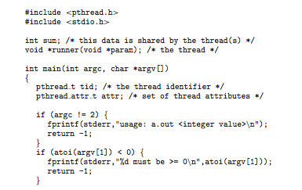
Pthreads Example

Slide 39
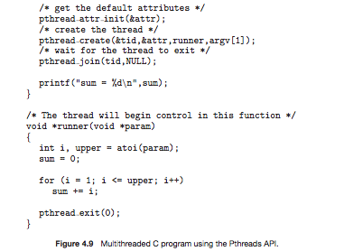
Pthreads Example (Cont.)

Slide 40
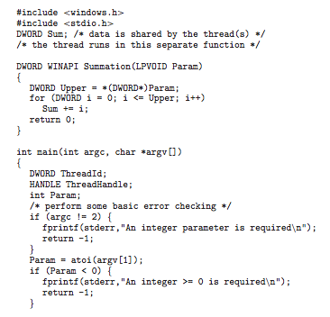
Win32 API Multithreaded C Program

Slide 41
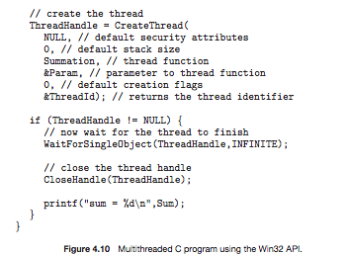
Win32 API Multithreaded C Program (Cont.)

Slide 42
Java Threads
Java threads are managed by the JVM
Typically implemented using the threads model provided by underlying OS
Java threads may be created by:
Extending Thread class
Implementing the Runnable interface

Slide 43
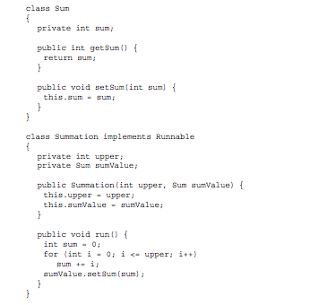
Java Multithreaded Program

Slide 44
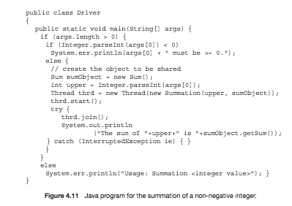
Java Multithreaded Program (Cont.)

Slide 45
Threading Issues
Semantics of fork() and exec() system calls
Thread cancellation of target thread
Asynchronous or deferred
Signal handling
Synchronous and asynchronous

Slide 46
Threading Issues (Cont.)
Thread pools
Thread-specific data
Create Facility needed for data private to thread
Scheduler activations

Slide 47
Semantics of fork() and exec()
Does fork() duplicate only the calling thread or all threads?

Slide 48
Thread Cancellation
Terminating a thread before it has finished
Two general approaches:
Asynchronous cancellation terminates the target thread immediately.
Deferred cancellation allows the target thread to periodically check if it should be cancelled.

Slide 49
Signal Handling
Signals are used in UNIX systems to notify a process that a particular event has occurred.
A signal handler is used to process signals
Signal is generated by particular event
Signal is delivered to a process
Signal is handled
Options:
Deliver the signal to the thread to which the signal applies
Deliver the signal to every thread in the process
Deliver the signal to certain threads in the process
Assign a specific thread to receive all signals for the process

Slide 50
Thread Pools
Create a number of threads in a pool where they await work
Advantages:
Usually slightly faster to service a request with an existing thread than create a new thread
Allows the number of threads in the application(s) to be bound to the size of the pool

Slide 51
Thread Specific Data
Allows each thread to have its own copy of data
Useful when you do not have control over the thread creation process (i.e., when using a thread pool)

Slide 52
Scheduler Activations
Both M:M and Two-level models require communication to maintain the appropriate number of kernel threads allocated to the application
Scheduler activations provide upcalls - a communication mechanism from the kernel to the thread library
This communication allows an application to maintain the correct number kernel threads

Slide 53
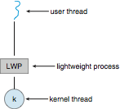
Lightweight Processes

Slide 54
Operating System Examples
Windows XP Threads
Linux Thread
Notes:
54

Slide 55
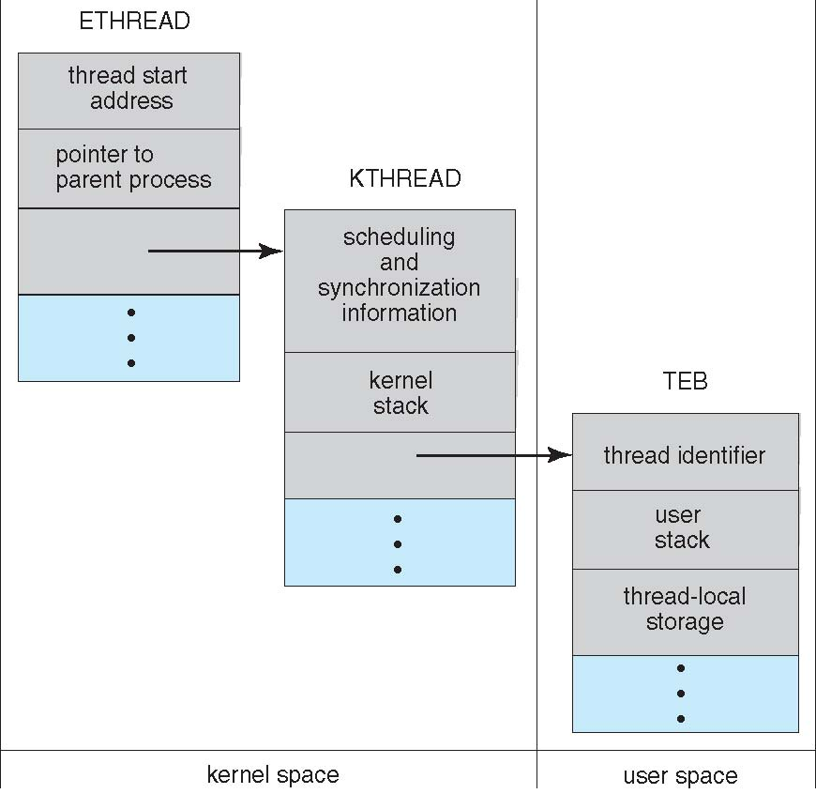
Windows XP Threads Data Structures

Slide 56
Windows XP Threads
Implements the one-to-one mapping, kernel-level
Each thread contains
A thread id
Register set
Separate user and kernel stacks
Private data storage area
The register set, stacks, and private storage area are known as the context of the threads
The primary data structures of a thread include:
ETHREAD (executive thread block)
KTHREAD (kernel thread block)
TEB (thread environment block)

Slide 57
Linux Threads
Linux refers to them as tasks rather than threads
Thread creation is done through clone() system call
clone() allows a child task to share the address space of the parent task (process)
struct task_struct points to process data structures (shared or unique)

Slide 58
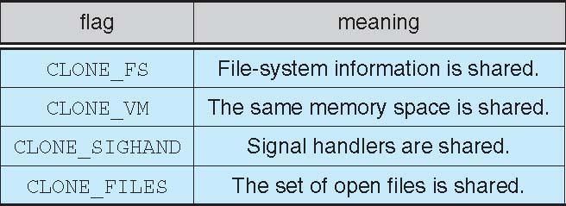
Linux Threads
fork() and clone() system calls
Doesn’t distinguish between process and thread
Uses term task rather than thread
clone() takes options to determine sharing on process create
struct task_struct points to process data structures (shared or unique)

